Slide 1
Interest Rate Models
June 2020

Slide 2
Interest Rate Term Structure Models
Term structure: Relationship between interest rates or bond yields at different terms or maturities. Summarized by the yield curve.
Model | Continuous or Discrete Time | Model Factors | Arbitrage-Free or Equilibrium | Fitted or Non-Fitted
Cox-Ingersoll-Ross [CIR] | Continuous | (1) Short rate | Arbitrage-Free | Non-Fitted
Heath-Jarrow-Morton [HJM] | Continuous | Various | Arbitrage-Free | Auto
Nelson-Siegel [N-S] | - | Long rate, Yield curve slope, Yield curve “bow” | Equilibrium | Fitted
Diebold-Li (dynamic N-S) | Discrete |  | Equilibrium | Fitted

Slide 3
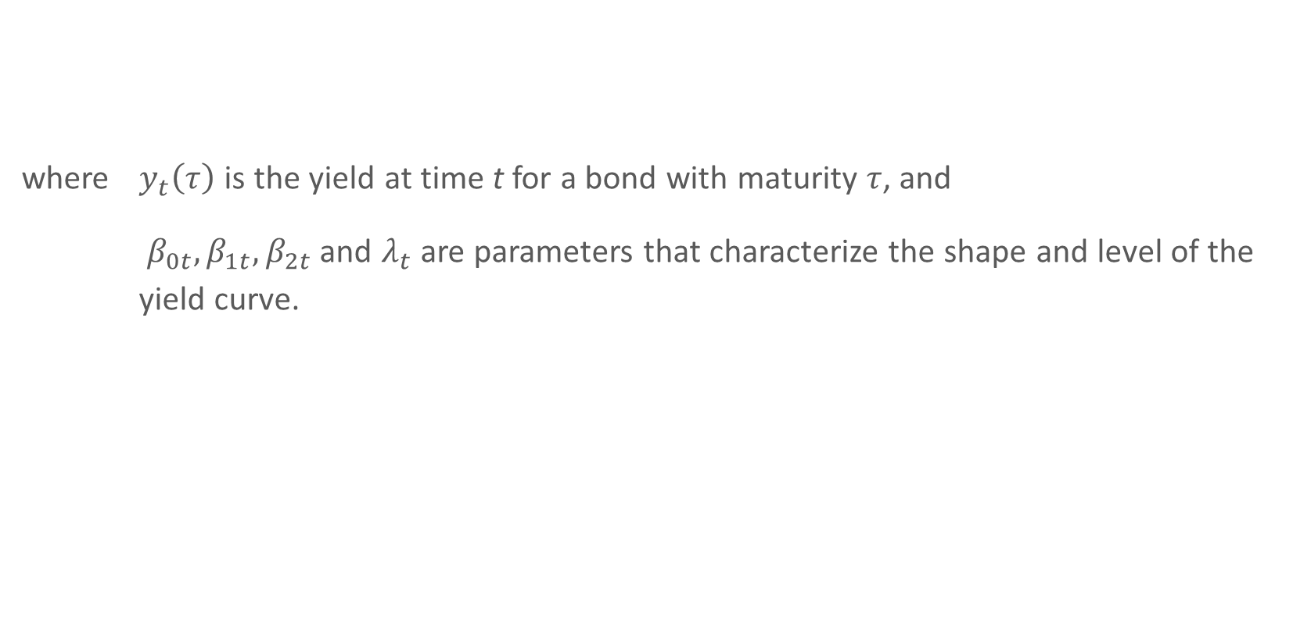
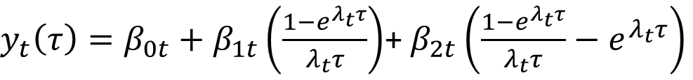
Nelson-Siegel Dynamic Factor Model
where $y_{t}\left(τ\right)$ is the yield at time t for a bond with maturity $τ$, and
$β_{0t},β_{1t},β_{2t}$ and $λ_{t}$ are parameters that characterize the shape and level of the yield curve.
$y_{t}\left(τ\right)=β_{0t}+β_{1t}\left(\frac{1−e^{λ_{t}τ}}{λ_{t}τ}\right)$+ $β_{2t}\left(\frac{1−e^{λ_{t}τ}}{λ_{t}τ}−e^{λ_{t}τ}\right)$

Slide 4
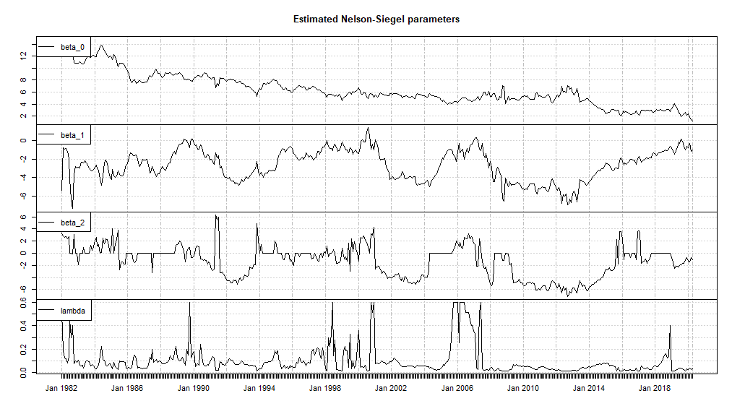
Estimated Nelson-Siegel Parameters (1982-2019)

Slide 5
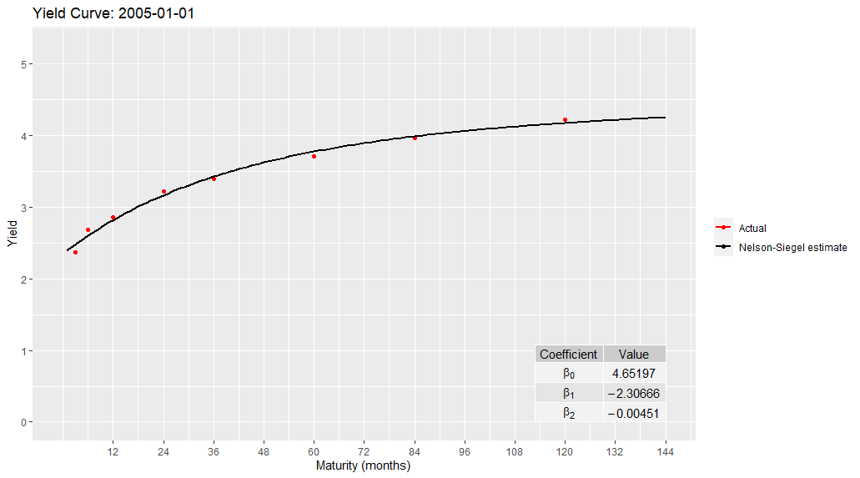
Fitted Yield Curve from Jan-2005 N-S Parameters

Slide 6
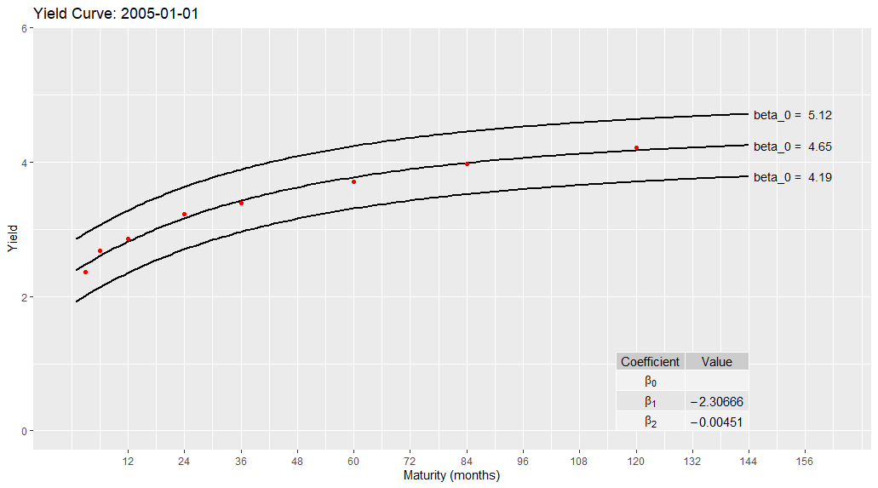
$β_{0}$ Sets the Level of the Yield Curve

Slide 7
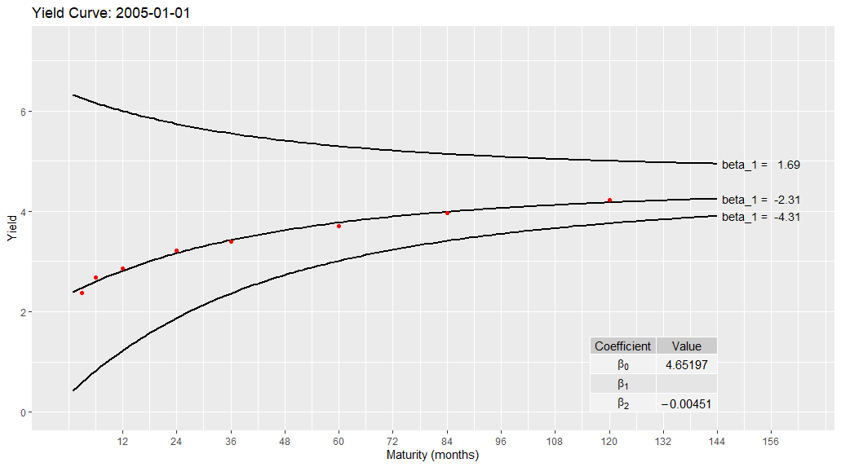
$β_{1}$ Determines the Slope of the Yield Curve

Slide 8
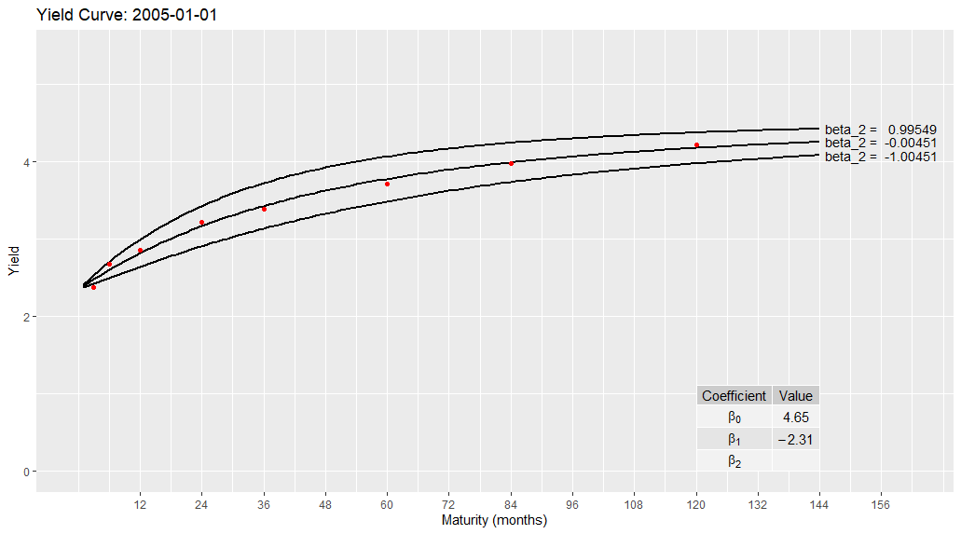
$β_{2}$ Controls the “Bow” of the Yield Curve

Slide 9
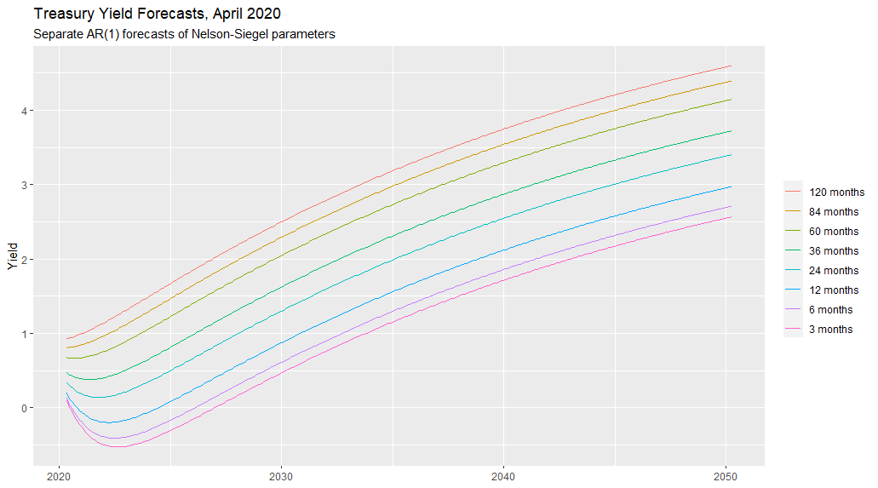
Interest Rate Forecasts from Dynamic Nelson-Siegel Model

Slide 10
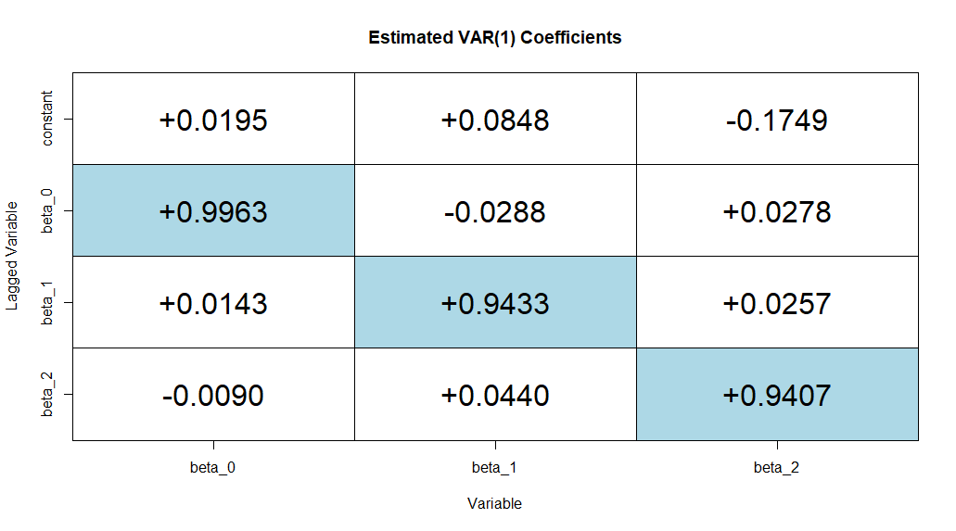
N-S Factors Can Be Forecast with Any Model

Slide 11
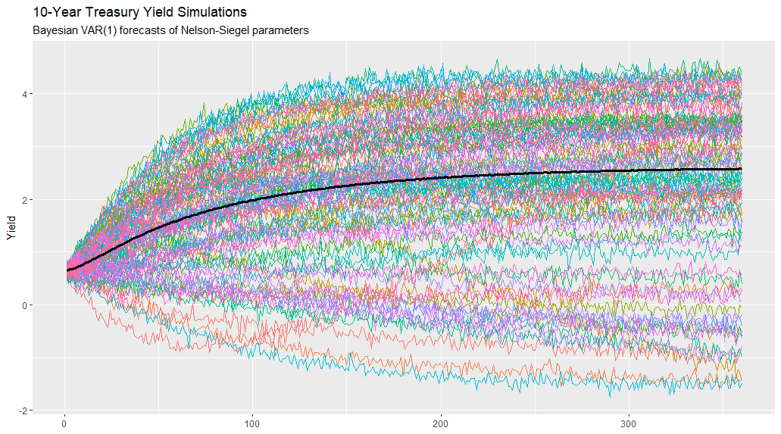
N-S Forecast Model Can Be Used for Simulation

Slide 12
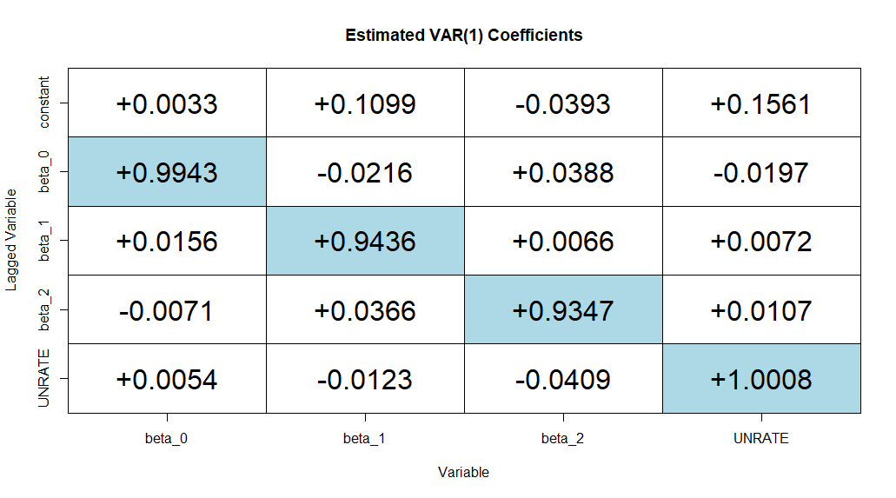
N-S Factors Can Be Modelled Against Economic Variables …

Slide 13
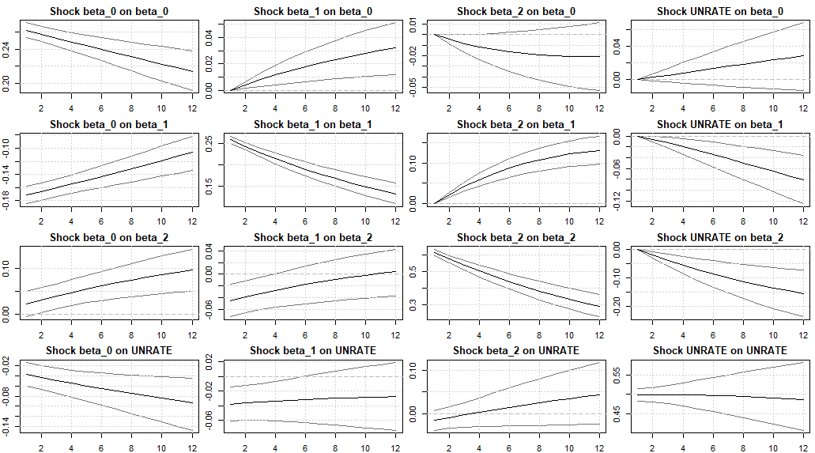
… But Model Responses May Not Make Sense …
Impulse Response Functions

Slide 14
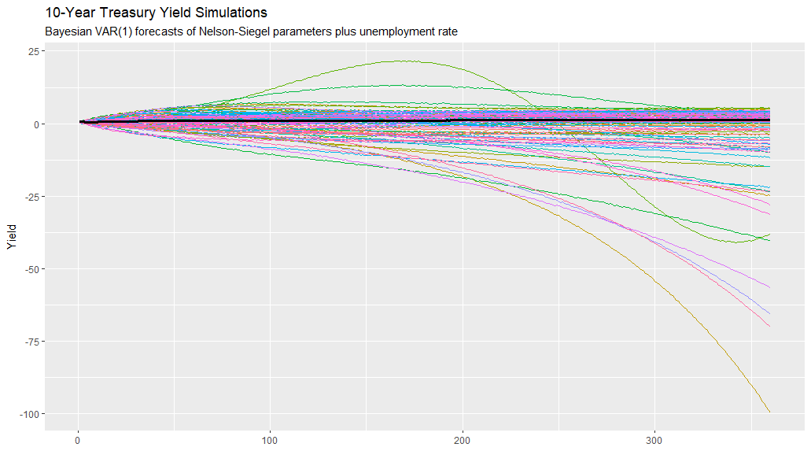
… Leading to Strange Simulations

